Slide 1
Cater extract
Presented by:
Arkadi Doktorovich, Hen Mandelbaum

Slide 2
Motivation
Business agreements are often finalized through email thread negotiations, Important contractual details are embedded implicitly across several messages making manual extraction time consuming and error prone.
The goal of this project is to automatically extract structured contract attributes from catering email threads and output them in a fixed JSON schema.

Slide 3
Project definition
For models we used a LLM that uses a prompt (GPT 4-o-mini for zero-shot and few-shot), supervised Transformer (DistilBERT multi-head) along with GLiNER as our NER model.
For the Dataset we created 1,000 synthetic but realistic email threads with aligned JSON ground truths.
The metrics used are Field level exact match / overlap scores, regression tolerance accuracy, multi label F1, and overall average score.

Slide 4
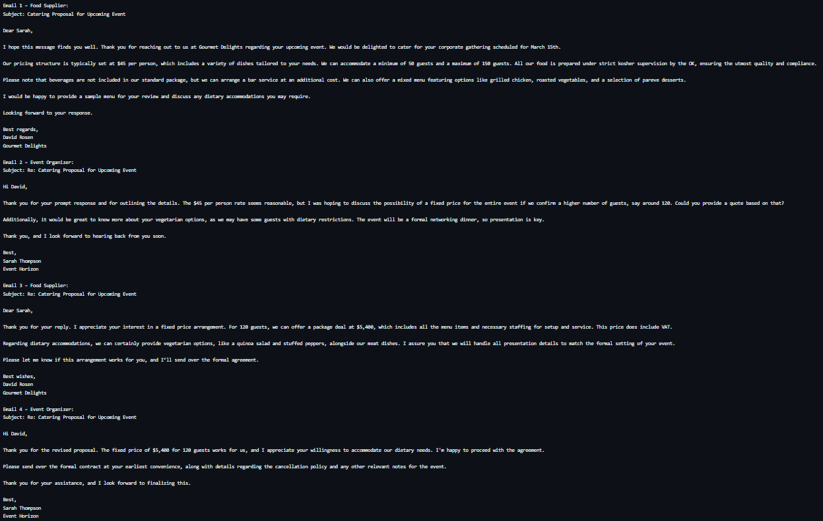

Slide 5
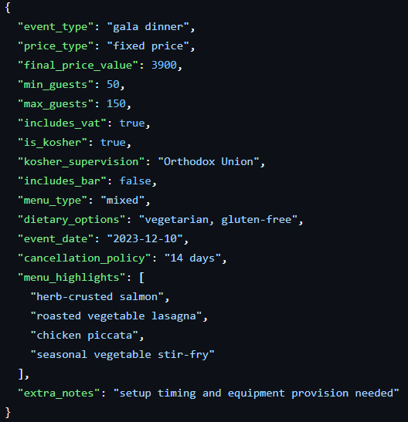
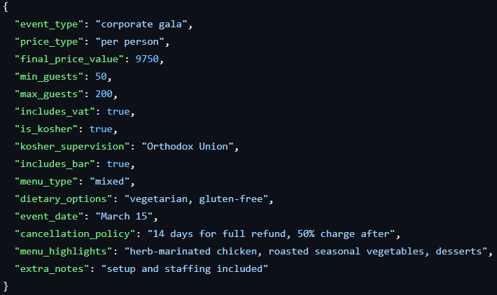

Slide 6
Achievements and Novelty
Accomplishments:
Trained a supervised extraction model that outperformed zero-shot and few-shot LLMs on structured feature extraction.
Finding a close to perfect prompt for business email threads generation.
Novelty:
Focus on negotiation aware information extraction rather than single email or sentence level extraction.
Direct comparison between LLM based extraction and supervised multi-task learning under the same schema.

Slide 7
Methodology
Project process:
Defined a structured schema and aligned all models to the same output format.
Trained, evaluated, and compared multiple extraction approaches.
Data & Models:
Prepared a dataset of 1000 synthetic email thread negotiations with JSON ground truth.
Evaluated:
  GPT 4-o-mini, LLM zero-shot & few-shot prompting.
  DistilBERT, Supervised Transformer based model.
  GLiNER, NER-based extraction baseline.
Metrics: field-level Precision, Recall, and F1-score.
Efforts:
Training from ground zero the Supervised Transformer based model.
Prompt engineering and consistency checks for LLM outputs and data creation.

Slide 8
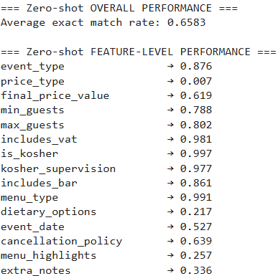
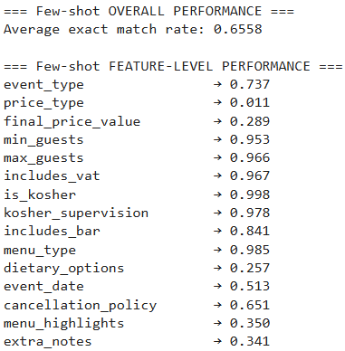
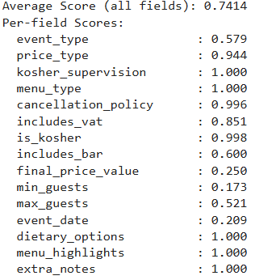
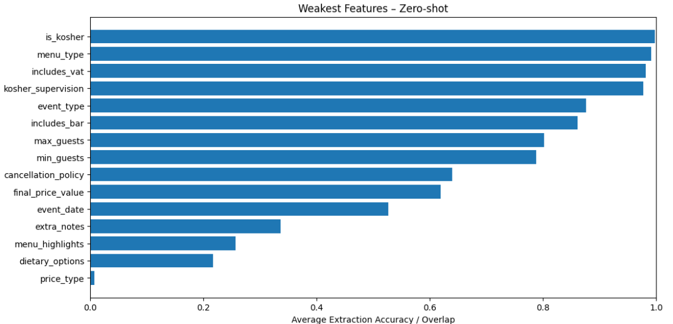
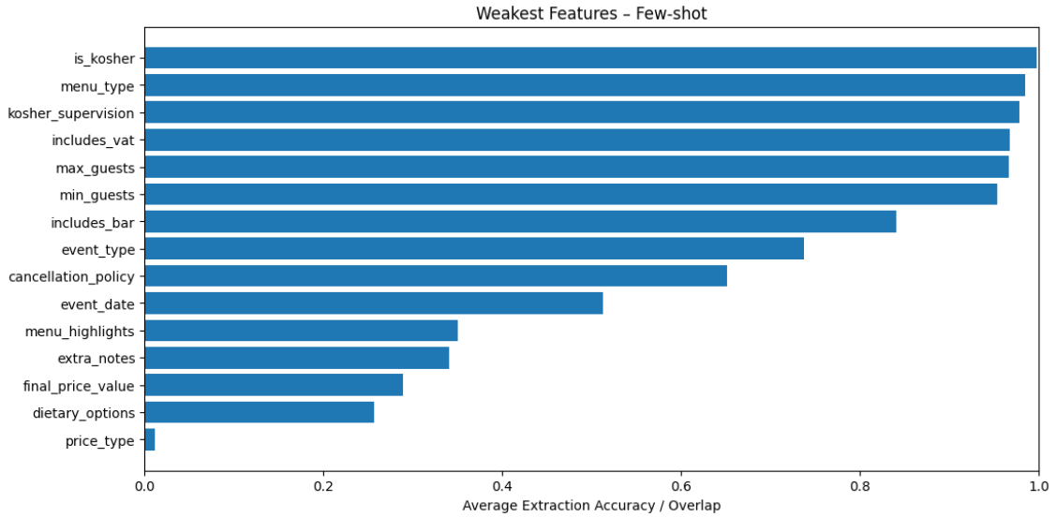
Results

Slide 9
Conclusion
Our goals were to outperform the LLM models, and we successfully did it after working on the supervised transformer-based model.
Things we learnt:
Schema design and annotation consistency are as critical as model choice.
Prompting alone is insufficient for high precision structured extraction.
Additional ideas:
Hybrid approaches combining LLM reasoning with supervised extraction.
Expand dataset size and include real world negotiation data.

